Slide 1


BSET Annual Meeting
28th June 2019
A Best Practice
Clinical Care Pathway for
PERIPHERAL ARTERIAL DISEASE
Professor Rob Fisher
Consultant Vascular Surgeon
LiVES, Liverpool
Mr Marcus Brooks
Consultant Vascular Surgeon
North Bristol NHS Trust

Slide 2


Vascular GIRFT (2018)
Found that the delivery of revascularization in critical limb ischaemia is inconsistent across UK, in terms of
service provision
length of hospital stays
patient outcomes
Universally unacceptable pathway delays to revascularization for people with CLI.
Supervised exercise for intermittent claudication cannot be accessed in many parts of the UK.

Slide 3
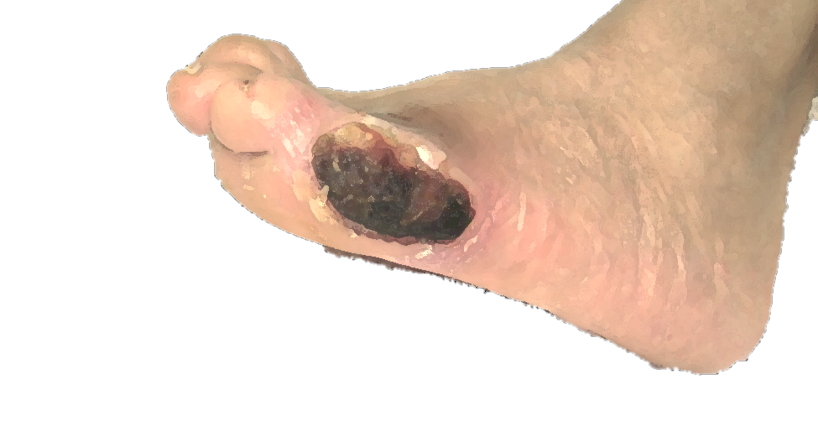
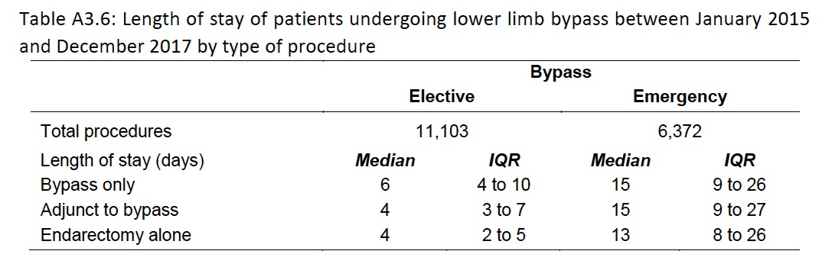
Scale of the problem
An 800,000 population can expect to average daily
One presentation with critical limb ischaemia
Five presentations with diabetic foot problems
POVS 2018

Slide 4

The QIF describes how to improve outcomes;
Care pathways
Workforce
Facilities
The aims are
Reduced unwanted variation across the UK
Reduced morbidity and mortality from C-V disease
IC, sustained improvement in walking distance
CLI, restoration of pain-free and functional limb

Slide 5
Acknowledgements
Mr David Cromwell (Clinical Effectiveness Unit, The Royal College of Surgeons of England)
Mr Sam Waton (National Vascular Registry)
Prof Michael Horrocks (Clinical Lead Vascular GIRFT)
Dr William Jeffcoate (National Diabetic Foot Ulcer Audit of England and Wales)
Mr Martin Fox (The College of Podiatry)
Mr Dominic Foy (Society of Vascular Technologists)
Ms Louise Allen (Society of Vascular Nurses)
Dr Peter Billingham (Bristol Vascular Patient Involvement Group)

Slide 6
QIF’s four key aims
1. Evidence based, well organised, care for people with PAD, focusing on CV risk factor modification.
2. Equitable access for people with PAD to
supervised exercise
timely revascularisation
3. Every vascular network has a lower limb multi-disciplinary team, that collaborates closely with local MDFTs.
4. Every patient receives a multi-specialty assessment, including shared decision over treatment.

Slide 7
Best Practice
PAD
C-V risk modification
Education for community nurses and podiatrists in diagnosis and treatment
Community access to ABPI measurement
IC
C-V risk modification
Supervised exercise programme
Failure to respond to SET may lead to referral for consideration of angioplasty or bypass.
Naftidrofuryl oxalate when no easy revascularization option.
CLI
early revascularization, to prevent limb loss.
Assessment requires a multi-professional team, lower limb MDT, available 24/7.
Open bypass surgery delivered in network arterial centres.
Endovascular therapy best delivered through day care, either at arterial centre or a networked hospital.
Best practice involves active participation in audit and research.

Slide 8
Best Practice
Acute diabetic foot
MDFT can help with network transfers and recovery from surgery.
Preventive care should be agreed with the MDFT and foot protection team.
MDFTs should ensure episodes registered National Diabetes Foot Care Audit.
Deep foot sepsis
Patients presenting with deep foot sepsis should have debridement and/or drainage within 24 hours.
Non-salvageable foot
The VSGBI Major Amputation StAMP sets out the best practice clinical care pathway for lower limb amputation.
Amputation should be performed within 48 hours of decision.

Slide 9
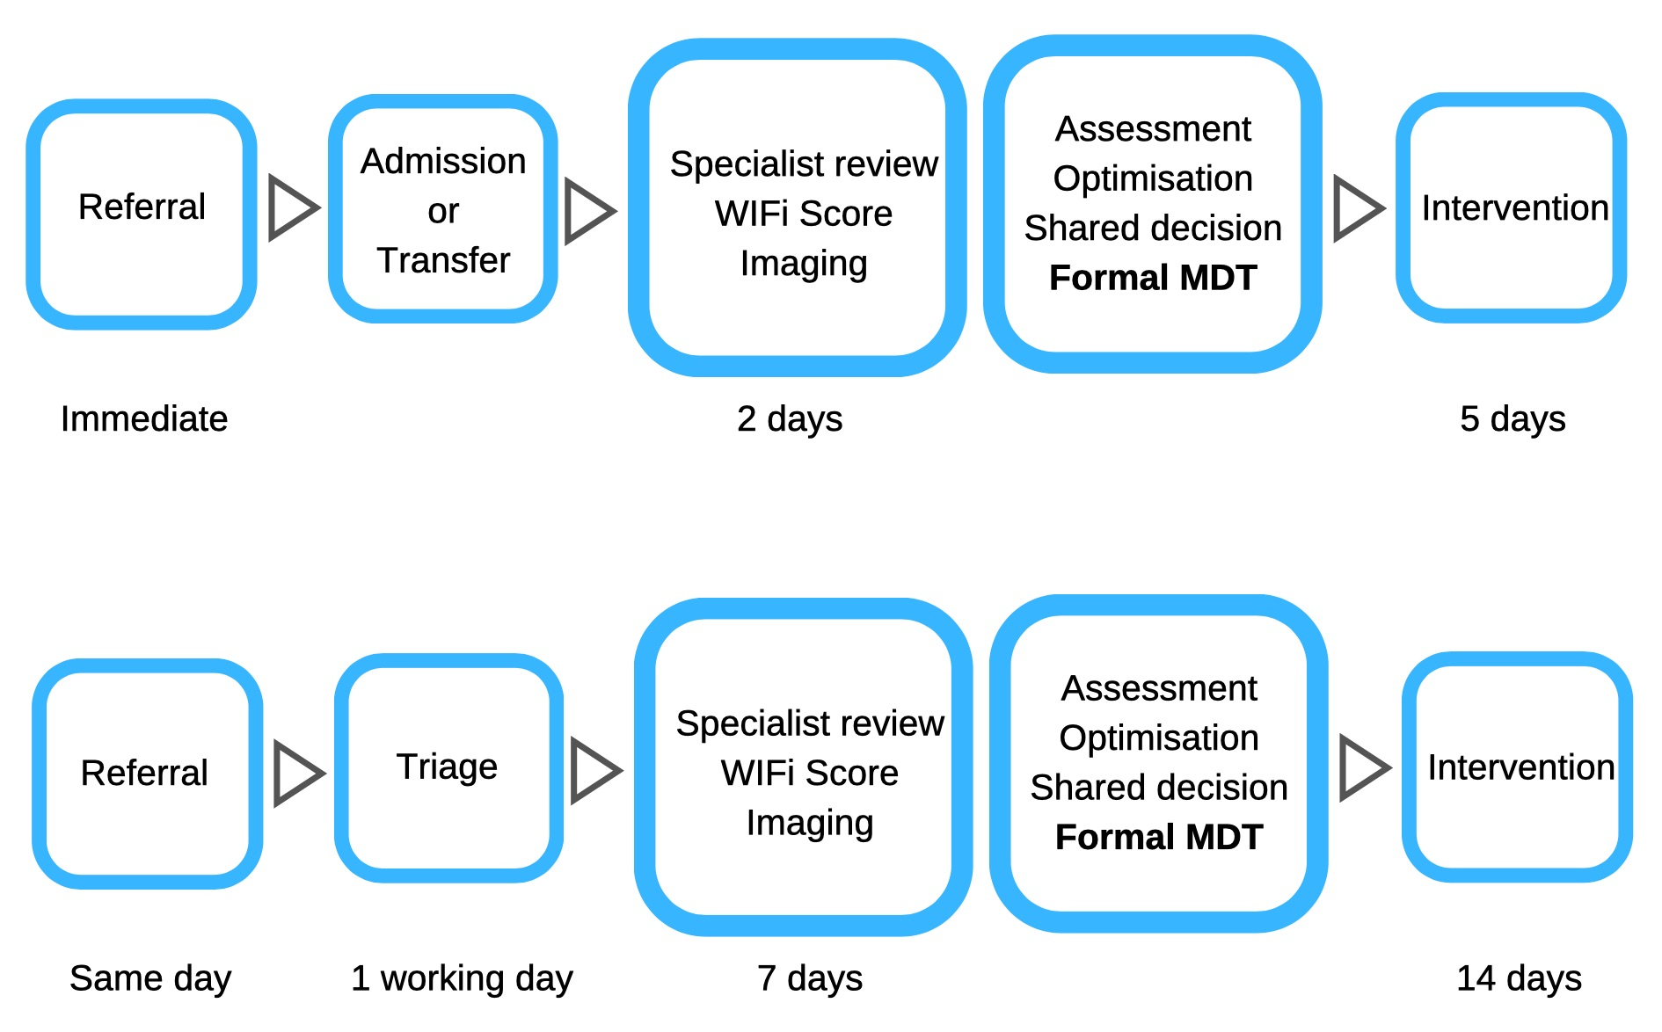
Timelines
Admitted patient - severe critical limb ischaemia and/or foot sepsis
Non-admitted patient - stable disease, such as mummified toes

Slide 10
The QIF timelines are deliberately challenging
SOME REGIONS |  | ALL REGIONS
Reorganization, based upon the network model described in the VSGBI’s Provision of Vascular Services will be needed. |  | Network leads will need to work with trusts, clinical commissioning groups and other healthcare specialties, especially multi-disciplinary diabetic foot care teams, to implement this QIF.
This QIF is aligned with the Vascular GIRFT recommendation that vascular networks develop processes to deliver urgent care.

Slide 11
Pathway of Care
Pre-intervention assessment
Shared decision making
Hospital admission
Conservative or
End of life care
Open surgical revascularization
Arterial centre (AC)
Endovascular procedure
AC or Day case Non-AC
Major lower limb amputation
Arterial centre (AC)
Recovery
Timely revascularisation requires sufficient arterial centre beds and vascular operating theatre capacity, including at weekends.

Slide 12

Multi-disciplinary team
Core members
Formal lower limb MDT meeting Vascular surgeon - at least two Interventional radiologist - at least two Vascular nurse specialist Vascular anaesthetist Consultant in care of elderly and frailty Vascular scientist MDT administrator
Regular professional working Podiatrist Vascular ward & IR day care unit nurses Vascular ward and amputee therapists Nutrition team Diabetes specialist nurse Waiting list coordinator - or equivalent Discharge coordinator - or equivalent
Input available from
Acute pain team Acute medicine Cardiology Respiratory medicine Renal, including access to dialysis Endocrinology Plastic surgery – for skin cover Orthotics Microbiology Tissue viability nurse Amputation councillor Rehabilitation consultant Palliative care team Network manager
This model of care borrows from the one successfully implemented by multi-disciplinary diabetic foot care teams

Slide 13
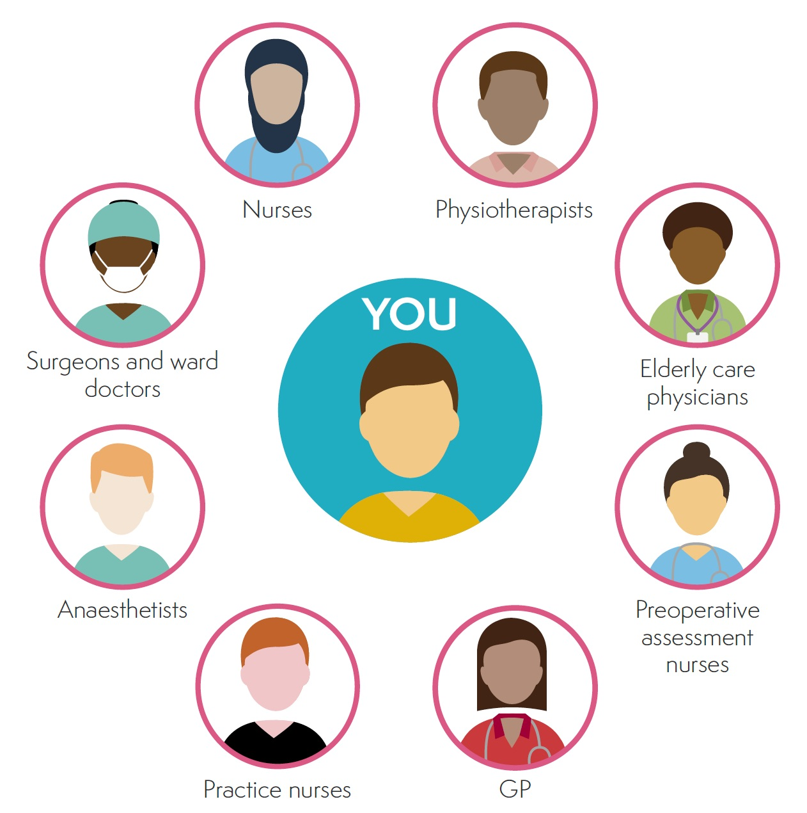
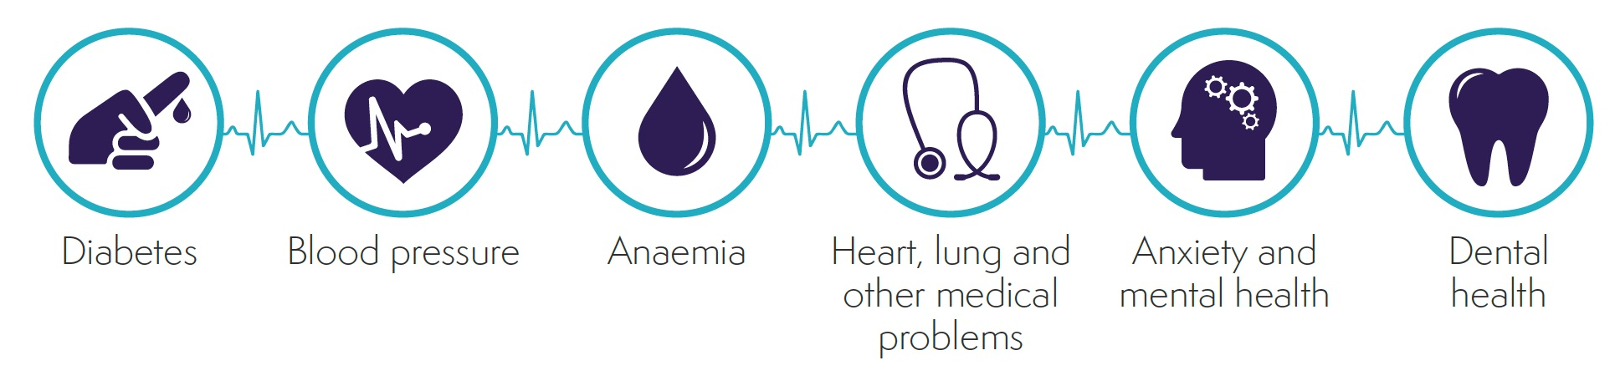
Pre-intervention assessment
A well-prepared patient is likely to have better outcome
fewer complications
fewer days of hospital stay
less chance of early readmission
  Elderly or Frail
  Poor nutrition
  Co-morbidities

Slide 14
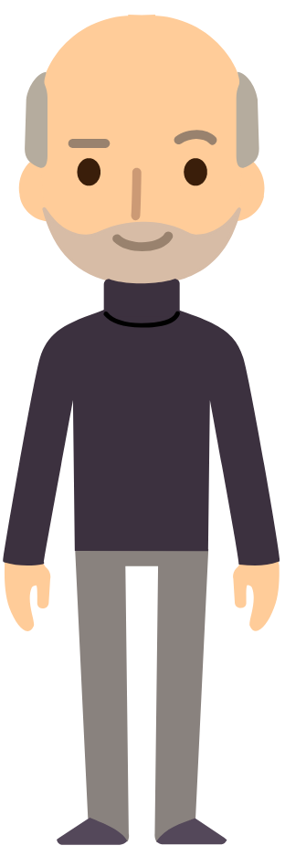



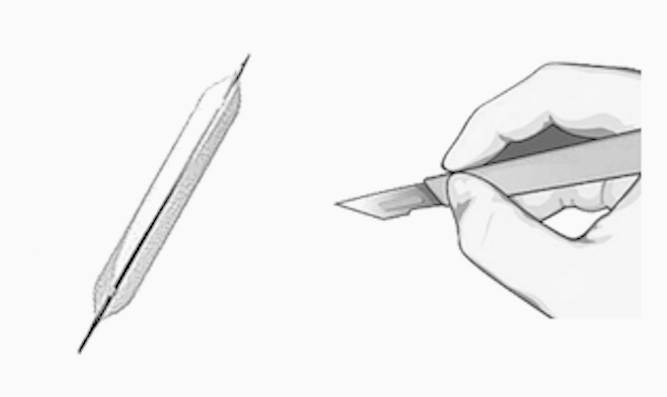

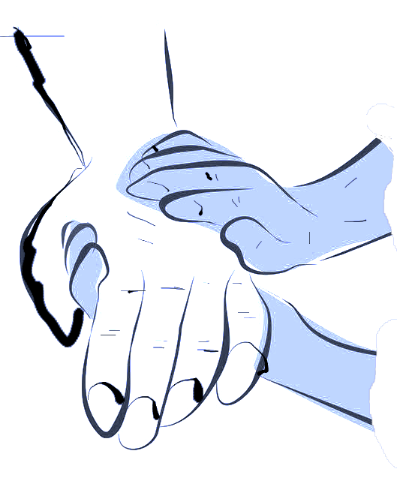
Shared decision
Individualised
Assessment
Multi–speciality
Discussion
Benefits and Risks for all treatment options
Nurses, physiotherapists and amputee councillors all have an important roles in exploring patient understanding and concerns. Must provide written information.

Slide 15
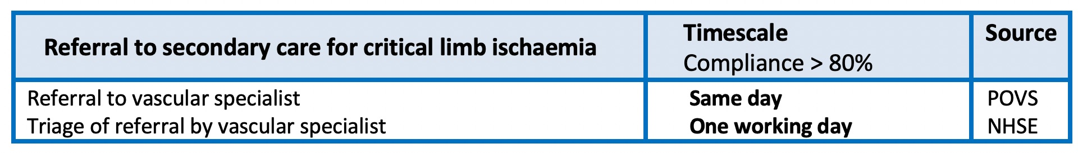
QIF STANDARDS 1

Slide 16
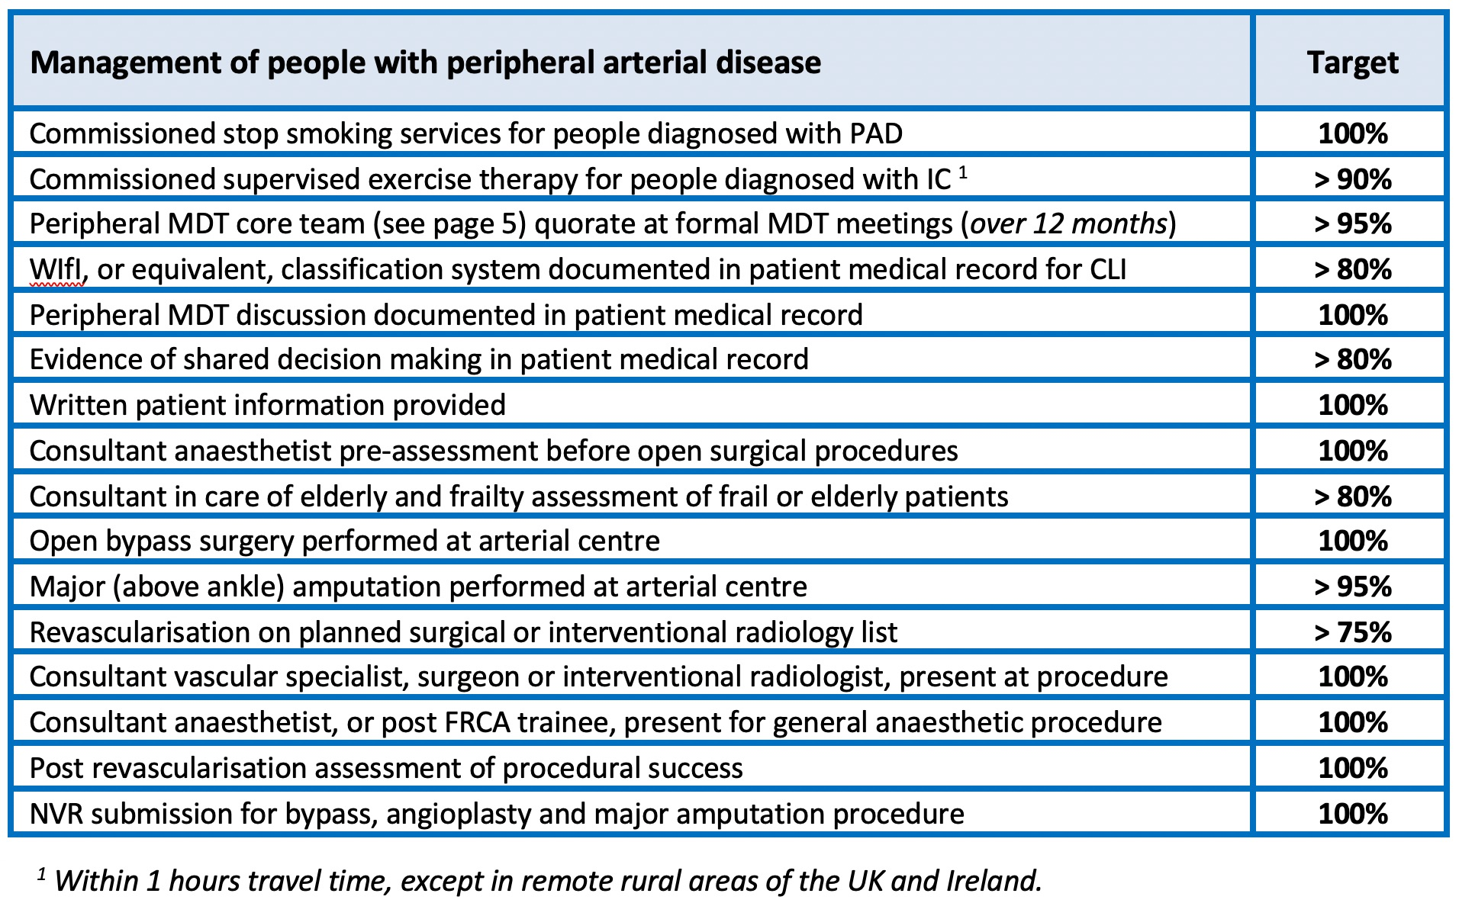
QIF STANDARDS 2

Slide 17
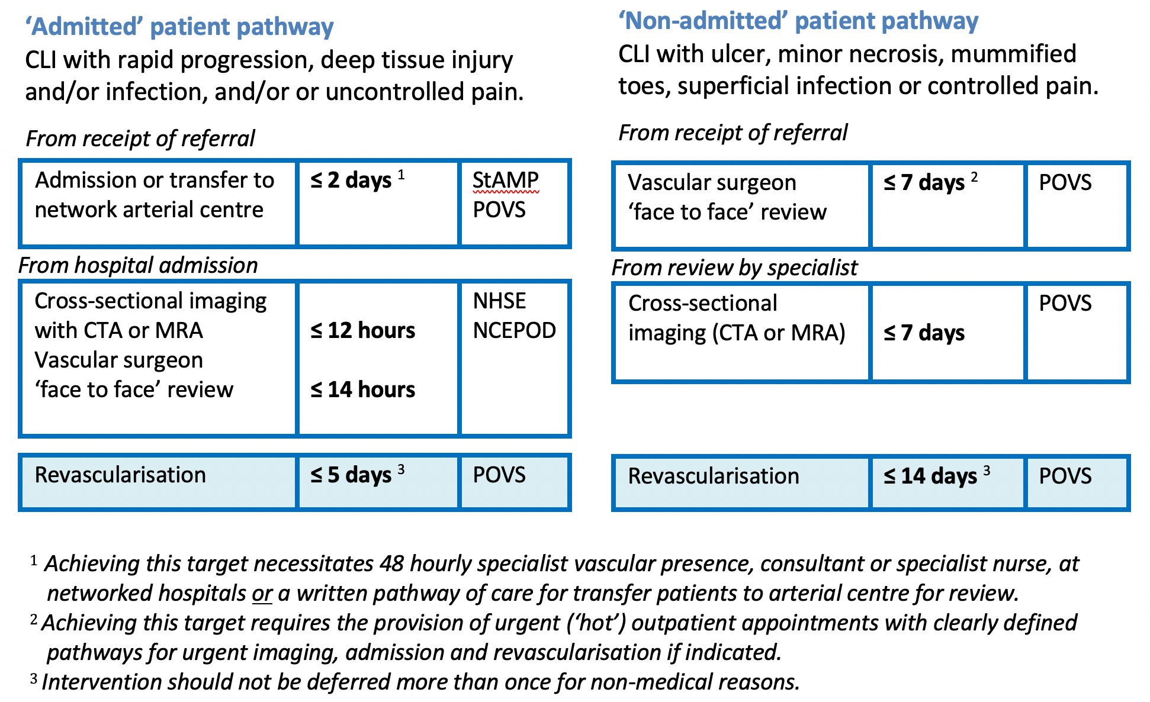
QIF STANDARDS 3

Slide 18



What next?
  QIF Fellow interview 15th July
  (joint funded RCS and Circulation Foundation)
  Lead implementation sites identified
  To share best practice
  GIRFT visits
  Data reporting via National Vascular Registry
  To monitor progress against standards

Slide 19
QIF writing group
Mr Jonathan Boyle (Chair) Cambridge
Mr Marcus Brooks Bristol
Dr Richard Biram Cambridge
Mr Mike Clark Newcastle
Prof Robert Fisher Liverpool
Mr Denis Harkin Belfast
Dr Fiona Miller (BSIR) King’s College, London
Dr Ronelle Mouton (VASBGI) Bristol
Ms Anna Murray (Trainee) West Midlands

